Slide 1
P&S Heterogeneous Systems
Advanced Tiling for Matrix Multiplication
Dr. Juan Gómez Luna
Prof. Onur Mutlu
ETH Zürich
Fall 2022
28 November 2022

Slide 2
Parallel Patterns

Slide 3
Reduction Operation
A reduction operation reduces a set of values to a single value
  Sum, Product, Minimum, Maximum are examples
Properties of reduction
  Associativity
  Commutativity
  Identity value
Reduction is a key primitive for parallel computing
  E.g., MapReduce programming model
Dean and Ghemawat, “MapReduce: Simplified Data Processing of Large Clusters,” OSDI 2004

Slide 4
Divergence-Free Mapping (I)
All active threads belong to the same warp
Thread 0
Thread 1
Thread 2
…
Thread 14
Thread 15
0
1
2
3
…
13
14
15
16
17
18
19
1
0+16
15+31
2
iterations
3
Slide credit: Hwu & Kirk

Slide 5
Divergence-Free Mapping (II)
Program with high SIMD utilization
  __shared__ float partialSum[]
  unsigned int t = threadIdx.x;
  for(int stride = blockDim.x; stride > 0; stride >> 1){
  __syncthreads();
  if (t < stride)
  partialSum[t] += partialSum[t + stride];
  }
Warp 0
Warp 1
Warp 2
Warp 3
stride = 16
Warp utilization
is maximized
stride = 8
stride = 4

Slide 6
Histogram Computation
Histogram is a frequently used computation for reducing the dimensionality and extracting notable features and patterns from large data sets
  Feature extraction for object recognition in images
  Fraud detection in credit card transactions
  Correlating heavenly object movements in astrophysics
  …
Basic histograms - for each element in the data set, use the value to identify a “bin” to increment
  Divide possible input value range into “bins”
  Associate a counter to each bin
  For each input element, examine its value and determine the bin it falls into and increment the counter for that bin
Slide credit: Hwu & Kirk

Slide 7
Parallel Histogram Computation: Iteration 2
All threads move to the next section of the input
  Each thread moves to element threadID + #threads
I
_
C
A
L
C
U
L
A
T
E
_
A
_
H
I
S
T
O
G
R
A
M
Thread 0
Thread 1
Thread 2
Thread 3
We need to use atomic operations
1
1
2
1
1
2
1
_
A
B
C
D
E
F
G
H
I
J
K
L
M
N
O
P
Q
R
S
T
U
V …

Slide 8
Histogram Privatization
Privatization: Per-block sub-histograms in shared memory
  Threads use atomic operations in shared memory
Block 0’s sub-histo
Block 1’s sub-histo
Block 2’s sub-histo
Block 3’s sub-histo
Shared memory
Parallel reduction
Global memory
Final histogram

Slide 9
Convolution Applications
Convolution is a widely-used operation in signal processing, image processing, video processing, and computer vision
Convolution applies a filter or mask or kernel* on each element of the input (e.g., a signal, an image, a frame) to obtain a new value, which is a weighted sum of a set of neighboring input elements
  Smoothing, sharpening, or blurring an image
  Finding edges in an image
  Removing noise, etc.
Applications in machine learning and artificial intelligence
  Convolutional Neural Networks (CNN or ConvNets)
* The term “kernel” may create confusion in the context of GPUs (recall a CUDA/GPU kernel is a function executed by a GPU)

Slide 10
1D Convolution Example
Commonly used for audio processing
Mask size is usually an odd number of elements for symmetry (5 in this example)
Calculation of P[2]:
N
N[0]
N[1]
N[2]
N[3]
N[4]
N[5]
N[6]
P
P[0]
P[1]
P[2]
P[3]
P[4]
P[5]
P[6]
1
2
3
4
5
6
7
3
8
57
16
15
3
3
Sum
M
M[0]
M[1]
M[2]
M[3]
M[4]
3
8
15
16
15
3
4
5
4
3
Partial products
Slide credit: Hwu & Kirk

Slide 11
Another Example of 2D Convolution
Input Layer
Output Layer
X
CNN filter
Y
1
2
3
4
5
6
7
1
2
3
4
5
W
2
3
4
5
6
2
3
4
5
6
7
8
1
2
3
2
1
3
4
5
6
7
8
9
2
3
4
3
2
3
4
321
6
7
4
5
6
7
8
5
6
3
4
5
4
3
4
5
6
7
8
2
3
4
3
2
5
6
7
8
5
5
6
7
8
5
6
7
1
2
3
2
1
6
7
8
9
0
1
2
7
8
9
0
1
2
3
1
4
9
8
5
Sum
Partial products
4
9
16
15
12
9
16
25
24
21
8
15
24
21
16
5
12
21
16
5
Slide credit: Hwu & Kirk

Slide 12
Implementing a Convolutional Layer with Matrix Multiplication
Slide credit: Reproduced from Hwu & Kirk

Slide 13
Efficient CNN on GPU

Slide 14
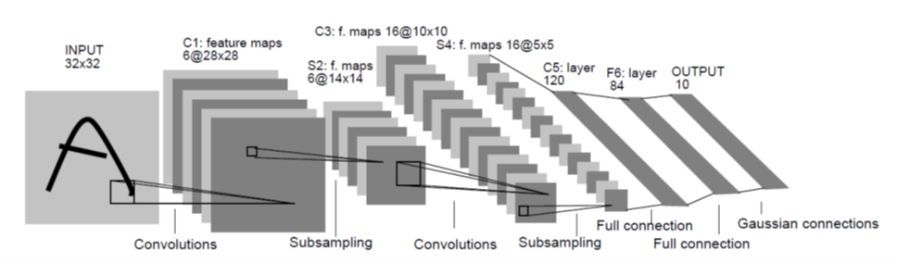
Convolutional Neural Networks
Neural network with Convolutional layers (combined with other types)
Example: LeNet-5, CNN for Hand-Written Digit Recognition
Slide credit: Hwu & Kirk & PUMPS+AI 2022

Slide 15
LeNet-5: CNN for Hand-Written Digit Recognition
6 filters of 5x5 pixels
Slide credit: Hwu & Kirk & PUMPS+AI 2022

Slide 16
LeNet-5: CNN for Hand-Written Digit Recognition
The filters are used in groups of 6 (# of input feature maps)
3D convolution of a 14x14x6 pixels input with 16 filters of 5x5x6 pixels each.
…
96 (6x16) filters of 5x5 px.
Slide credit: Hwu & Kirk & PUMPS+AI 2022

Slide 17
Example of the Forward Path of a Convolutional Layer
((N₁ - K₁+1) x (N₂ - K₂+1))
pixels each
(K₁ x K₂) pixels each
(N₁ x N₂) pixels each
Slide credit: Hwu & Kirk & PUMPS+AI 2022

Slide 18
Parallelism in a Convolution Layer
All output feature map pixels can be calculated in parallel
  Launch a single kernel to calculate all pixels of all output feature maps
  Each thread block calculates a tile of output feature map pixels
  Essentially a collection of summation of 2D tiled convolutions
See Kirk, Hwu, and El Hajj, PMPP 4th Edition Chapter 16 for such a kernel design
Slide credit: Hwu & Kirk & PUMPS+AI 2022

Slide 19
One possible Design of a Basic Kernel
Each block computes a tile of output pixels
  TILE_WIDTH pixels in each dimension
Thread Blocks Grid
  The X dimension maps to the M output feature maps
  The Y dimension maps to the tiles in the output feature maps (linearization)
Slide credit: Hwu & Kirk & PUMPS+AI 2022

Slide 20
Some Observations
The amount of parallelism is quite high as long as the total number of pixels across all output feature maps is large
  For early stages, there are fewer but larger output feature maps (large Y dimension)
  For later stages, there are more but smaller output feature maps (large X dimension)
  This scheme keeps the total number of threads stable across the stages
Slide credit: Hwu & Kirk & PUMPS+AI 2022

Slide 21
Some Observations (2)
Each input tile is loaded from global memory multiple times (by multiple blocks), once for each block that calculates the output tile that requires the input tile
  Not very efficient in global memory bandwidth
  This becomes more of a problem when the output feature maps become small (and increase in number)
Slide credit: Hwu & Kirk & PUMPS+AI 2022

Slide 22
Reducing Convolution Layers to Matrix Multiplications
Convolution layers are the compute intensive parts of a CNN
GPUs have extremely high-performance implementations of matrix multiplications
Tiling techniques for matrix multiplication naturally reuse input features across output feature maps
Converting convolutions in a convolution layer to a matrix multiplication helps to keep the level of parallelism stable across CNN layers
Slide credit: Hwu & Kirk & PUMPS+AI 2022

Slide 23
Implementing a Convolutional Layer with Matrix Multiplication
Slide credit: Reproduced from Hwu & Kirk

Slide 24
A C Function that Generates “Unrolled” X
01 void unroll(int C, int H, int W, int K, float* X, float* X_unroll) {
02 int H_out = H – K + 1;
03 int W_out = W – K + 1;
04 for(int c = 0; c < C; c++) {
// beginning row index of the section for channel C input feature
// map in the unrolled matrix
05 w_base = c * (K*K);
06 for(int p = 0; p < K; p++)
07 for(int q = 0; q < K; q++) {
08 int h_unroll = w_base + p*K + q;
09 for(h = 0; h < H_out; h++)
10 for(int w = 0; w < W_out; w ++) {
11 int w_unroll = h * W_out + w;
12 X_unroll[h_unroll, w_unroll) = X(c, h + p, w + q);
13 }
14 }
15 }
}
}
}
Slide credit: Hwu & Kirk & PUMPS+AI 2022

Slide 25
Implementing a Convolutional Layer with Matrix Multiplication
01 void unroll(int C, int H, int W, int K,
float* X, float* X_unroll) {
02 int H_out = H – K + 1;
03 int W_out = W – K + 1;
04 for(int c = 0; c < C; c++) {
// beginning row index of the section for channel
// C input feature map in the unrolled matrix
05 w_base = c * (K*K);
06 for(int p = 0; p < K; p++)
07 for(int q = 0; q < K; q++) {
08 int h_unroll = w_base + p*K + q;
09 for(h = 0; h < H_out; h++)
10 for(int w = 0; w < W_out; w ++) {
11 int w_unroll = h * W_out + w;
12 X_unroll[h_unroll, w_unroll) =
X(c, h + p, w + q);
13 }
14 }
15 }
}
}
}
H_out=W_out=2
K*K=2*2
C = 3

Slide 26
Simple Matrix Multiplication
1 | 2 | 1 | 1
2 | 0 | 1 | 3
1 | 1 | 0 | 2
1 | 3 | 2 | 2
0 | 2 | 0 | 3
2 | 1 | 3 | 2
0 | 3 | 1 | 1
3 | 2 | 1 | 0
1 | 2 | 1 | 1
2 | 1 | 0 | 3
0 | 1 | 3 | 3
1 | 3 | 3 | 2
0
Each product matrix element is an output feature map pixel
This inner product generates element 0 of output feature map 0
Input Feature Maps
1
2
Convolution Filters
0
Output Feature Maps
1 | 1 | 2 | 2 | 1 | 1 | 1 | 1 | 0 | 1 | 1 | 0
1 | 0 | 0 | 1 | 2 | 1 | 2 | 1 | 1 | 2 | 2 | 0
14 | 20 | 15 | 24
12 | 24 | 17 | 26
1
Slide credit: Hwu & Kirk & PUMPS+AI 2022

Slide 27
Tiled Matrix Multiplication 2x2 Shared-Memory Tiling (Toy Example)
Each block calculates one 2x2 output tile – 2 elements from each output map
Each block loads one 2x2 filter tile and one 2x2 input tile into the shared memory and performs two dot product steps for all its 2x2 output elements
Each input element is reused 2 times in the shared memory
1 | 2 | 1 | 1
2 | 0 | 1 | 3
1 | 1 | 0 | 2
1 | 3 | 2 | 2
0 | 2 | 0 | 3
2 | 1 | 3 | 2
0 | 3 | 1 | 1
3 | 2 | 1 | 0
1 | 2 | 1 | 1
2 | 1 | 0 | 3
0 | 1 | 3 | 3
1 | 3 | 3 | 2
0
Input Feature Maps
1
2
Convolution Filters
0
Output Feature Maps
1 | 1 | 2 | 2 | 1 | 1 | 1 | 1 | 0 | 1 | 1 | 0
1 | 0 | 0 | 1 | 2 | 1 | 2 | 1 | 1 | 2 | 2 | 0
14 | 20 | 15 | 24
12 | 24 | 17 | 26
1
Slide credit: Hwu & Kirk & PUMPS+AI 2022

Slide 28
Tiled Matrix-Matrix Multiplication (I)
N
C = A x B
B
N
Step 1: Load the first tile of each input matrix to shared memory (each thread loads one element)
N
N
A
C
N
N
Slide credit: Izzat El Hajj

Slide 29
Tiled Matrix-Matrix Multiplication (II)
B_{tile}
C_{tile} = A_{tile} x B_{tile}
Step 2: Each thread computes its partial sum from the tiles in shared memory (threads wait for each other to finish)
A_{tile}
C_{tile}
Slide credit: Izzat El Hajj

Slide 30
Tiled Matrix Multiplication 2x4 Shared-Memory Tiling (Another Toy Example)
Each block calculates one 2x4 output tile – 4 elements from each output map
Each block loads one 2x2 filter tile and one 2x4 input tile into the shared memory and performs two dot-product steps for all its 2x4 output elements
Each input element is reused 2 (or 4 for filters) times in the shared memory
1 | 2 | 1 | 1
2 | 0 | 1 | 3
1 | 1 | 0 | 2
1 | 3 | 2 | 2
0 | 2 | 0 | 3
2 | 1 | 3 | 2
0 | 3 | 1 | 1
3 | 2 | 1 | 0
1 | 2 | 1 | 1
2 | 1 | 0 | 3
0 | 1 | 3 | 3
1 | 3 | 3 | 2
0
Input Feature Maps
1
2
Convolution Filters
0
Output Feature Maps
1 | 1 | 2 | 2 | 1 | 1 | 1 | 1 | 0 | 1 | 1 | 0
1 | 0 | 0 | 1 | 2 | 1 | 2 | 1 | 1 | 2 | 2 | 0
14 | 20 | 15 | 24
12 | 24 | 17 | 26
1
Slide credit: Hwu & Kirk & PUMPS+AI 2022

Slide 31
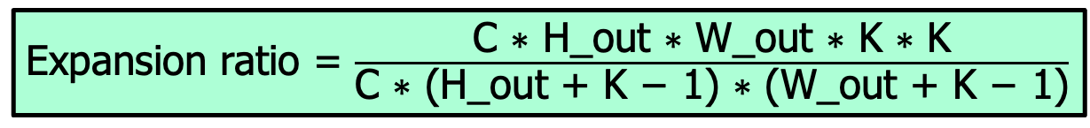
Analysis of Efficiency: Total Input Replication (I)
Each output map element requires its own replicated K*K input feature map elements
  Not replicated for different output feature maps
  There are H_out * W_out output feature map elements
  Each requires K * K replicated input feature map elements
  So, the total number of input elements after replication is H_out * W_out * K * K times for each input feature map
  The total number of elements in each original input feature map is (H_out + K - 1) * (W_out + K - 1)
Expansion ratio = $\frac{\text{C}\text{ ∗ }\text{H}\text{_}\text{out}\text{ ∗ }\text{W}\text{_}\text{out}\text{ ∗ }\text{K}\text{ ∗ }\text{K}}{\text{C}\text{ ∗ }\text{(}\text{H}\text{_}\text{out}\text{ + }\text{K}\text{ − 1) ∗ (}\text{W}\text{_}\text{out}\text{ + }\text{K}\text{ − 1)}}$
Slide credit: Hwu & Kirk & PUMPS+AI 2022

Slide 32
Analysis of Efficiency: Total Input Replication (II)
H_out = 2
W_out = 2
K = 2
There are C=3 input maps (channels)
The total number of input elements in the replicated (“unrolled”) input matrix is 3*2*2*2*2
The expansion ratio is (3*2*2*2*2)/(3*3*3) = 1.78
Slide credit: Hwu & Kirk & PUMPS+AI 2022

Slide 33
Tiled Matrix Multiplication is More Stable in Matrix Sizes
The filter-bank matrix is an M * C * K * K matrix
  M is the number of output feature maps
The expanded input feature map matrix is a C * K * K * H_out * W_out matrix
The sizes of the matrices depend on products of the parameters to the convolution, not the parameters themselves
For example, while H_out * W_out tends to decrease towards later stages of a CNN, C tends to increase at the same time
  The amount of work for each kernel launch will remain large as we go to the later stages of the CNN
Slide credit: Hwu & Kirk & PUMPS+AI 2022

Slide 34
More Details of Unrolling the Input Feature Maps (X)
The conversion from convolution to matrix multiplication can be done during execution
  The input feature maps are stored in their original form
  The kernel that implements a convolution layer performs a tiled matrix multiplication on the conceptual unrolled input matrix
  When loading each tile from the “unrolled input matrix”, the kernel extracts the tile elements from the original input feature maps based on a mapping like that used in the C code
  This way, there is no preprocessing cost and the input feature maps in the memory is not expanded due to unrolling
Slide credit: Hwu & Kirk & PUMPS+AI 2022

Slide 35
Advanced Tiling Techniques for Matrix Multiplication

Slide 36
Joint Register and Shared-Memory Tiling
Registers are accessed at extremely high throughput but
  Private to each thread
  Register tiling needs thread coarsening
Shared memory is accessed at lower throughput than registers but still much higher than global memory
  Visible to all threads in a block
  Does not need thread coarsening
  Still needs to be first loaded into registers before used by compute units
We typically use both for tiling different dimensions of a multidimensional data
One can use registers even more aggressively with warp programming and tensor cores
Slide credit: Hwu & Kirk & PUMPS+AI 2022

Slide 37
Data Reuse in Matrix Multiplication (Revisited)
N
Reuse of column data in N
Accessed by T1, T2, T3, T4
M
Accessed by T1
P
Accessed by T2
P
Accessed by T3
P
Accessed by T4
P
Slide credit: Hwu & Kirk & PUMPS+AI 2022

Slide 38
Data Reuse in Matrix Multiplication (Revisited)
N
Reuse of row data in M
Accessed by T1
Accessed by T2
Accessed by T3
Accessed by T4
M
Accessed by T1, T2, T3, T4
P
P
P
P
Slide credit: Hwu & Kirk & PUMPS+AI 2022

Slide 39
Data Reuse in Matrix Multiplication (Revisited)
Data Reuse in Matrix Multiplication:
Example 4x4 Output Tile
Only four elements of M and four elements of N are needed to calculate one step for a 16-element tile of P
N
M
P
Slide credit: Hwu & Kirk & PUMPS+AI 2022

Slide 40
Data Reuse in Matrix Multiplication (Revisited)
Data Reuse in Matrix Multiplication:
Example 4x2 Output Tile (I)
The P output tile does not need to be square
For a 4x2 tile
  4 elements of M and 2 elements of N are needed for each step
N
M
P
Slide credit: Hwu & Kirk & PUMPS+AI 2022

Slide 41
Data Reuse in Matrix Multiplication (Revisited)
Data Reuse in Matrix Multiplication:
Example 4x2 Output Tile (II)
Step 2…
N
M
P
Slide credit: Hwu & Kirk & PUMPS+AI 2022

Slide 42
Data Reuse in Matrix Multiplication (Revisited)
At each step
  For 4x2, only 6 elements need to be loaded for all 8 threads to make progress
  For 4x4, 8 elements for all 16 threads
N
M
P
Slide credit: Hwu & Kirk & PUMPS+AI 2022

Slide 43
In the Kernel of the Previous Slide
(e.g., 4x4 Output Tile)
TILE_WIDTH^2 elements of M and TILE_WIDTH^2 element of N are loaded
Each thread block calculates TILE_WIDTH steps for TILE_WIDTH^2 elements of P
  TILE_WIDTH is typically at least 16
According to our analysis, we can use much smaller amount of shared memory by
  Loading TILE_WIDTH element of M and TILE_WIDTH element of N (input tiles) to calculate 1 step for TILE_WIDTH^2 elements in the output tile
  So, why didn’t we do so?
Slide credit: Hwu & Kirk & PUMPS+AI 2022

Slide 44
Cost of Loading Smaller Input Tile
If in each iteration of the outer loop
  only a subset of threads load M and N elements (divergence or load imbalance)
  Call __synchthreads()
  All threads calculate one step of the inner product (inner loop degenerates to one iteration)
  Call __synchthreads()
  Go to the next iteration
Even though __synchthreads() is a very efficient function, such intensive use is still going to hurt
Slide credit: Hwu & Kirk & PUMPS+AI 2022

Slide 45
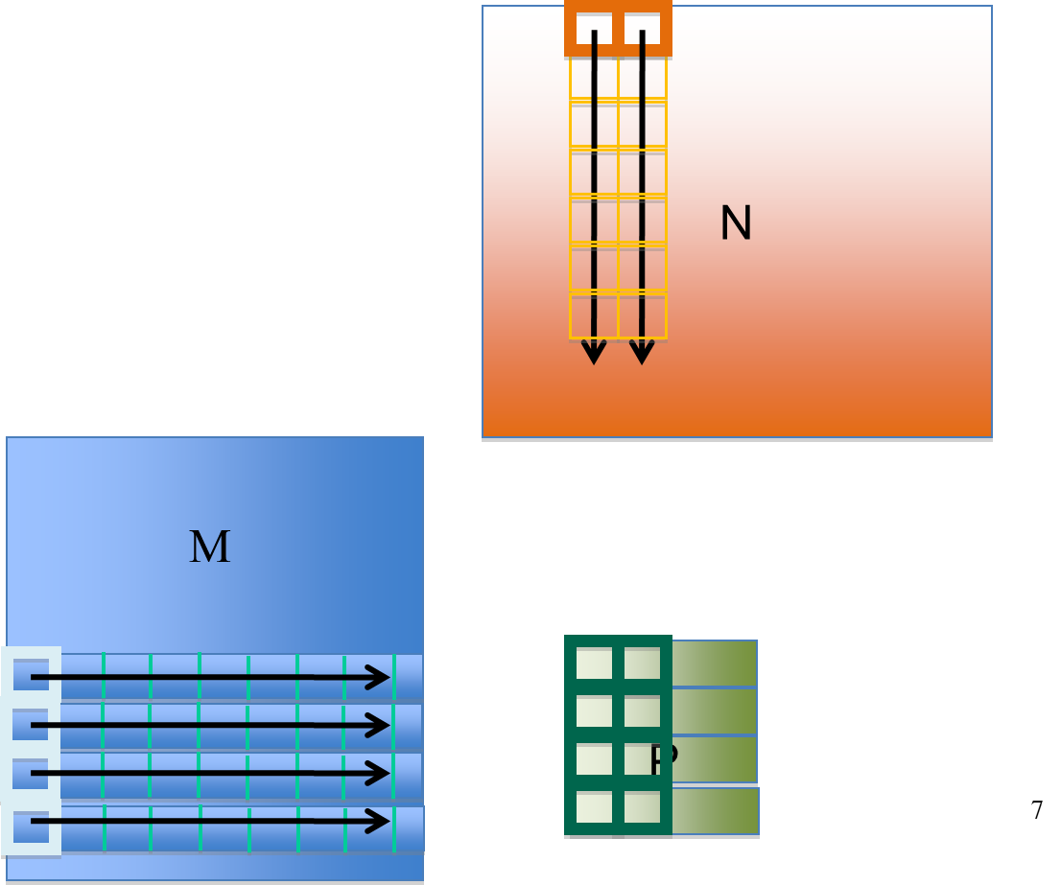
Joint Register and Shared Memory Tiling
Store input M tile and output P tile elements in registers
Store input N tile elements in shared memory
Decouple of M and N input tile widths
  TILE_WIDTH_M , TILE_WIDTH_N
Key quantities
  Number of threads = TILE_WIDTH_M
  Output tile size = TILE_WIDTH_M * TILE_WIDTH_N
  Reuses for each N element = TILE_WIDTH_M
  Reuses for each M element = TILE_WIDTH_N
  Each thread calculates TILE_WIDTH_N P elements
Example:
TILE_WIDTH_M = 4
TILE_WIDTH_N = 2
Slide credit: Hwu & Kirk & PUMPS+AI 2022

Slide 46
Joint Register and Shared Memory Tiling
Optimization 1: Thread Coarsening
Have each thread to calculate a horizontal strip of TILE_WIDTH_N P elements
Data loaded from M can be reused TILE_WIDTH_N times through registers
  Register tiling
M
N
M
Load 1 value from M into r1
r1 can be reused to compute 4 intermediate results for P
P[0] += r1 * n1;
P[1] += r1 * n2;
P[2] += r1 * n3;
P[3] += r1 * n4;
P
Slide credit: Hwu & Kirk & PUMPS+AI 2022

Slide 47
Joint Register and Shared Memory Tiling
Optimization 2: Shared Memory Tiling
Multiple threads collaborate to load TILE_WIDTH_N N elements into shared memory
B
N
M
T1-T4 cooperatively load 4 values from N, say n1~n4 into shared memory so T1-T4 can all use them
Accessed by T1
P
Accessed by T2
P
P
P
Slide credit: Hwu & Kirk & PUMPS+AI 2022

Slide 48
In One Iteration, Each Thread…
Accesses one M element from register, accesses TILE_WIDTH_N N elements from shared memory
  Calculates one step for TILE_WIDTH_N P elements
  TILE_WIDTH_N = ~16 in practice (limited by registers needed for P elements)
B
N
M
n1~n4 accessed from shared memory
Accessed by T1
P
Accessed by T2
P
Intermediate results computed by T1; stored in registers
P
P
Slide credit: Hwu & Kirk & PUMPS+AI 2022

Slide 49
In One Iteration, Each Block…
Has TILE_WIDTH_M threads
  64 or more in practice
Loads TILE_WIDTH_M M elements into registers, loads TILE_WIDTH_N N elements into shared memory
  TILE_WIDTH_N is number of threads folded into one thread in thread coarsening (16 or more in practice)
However, loading of N will involve only a subset of threads (divergence)
Slide credit: Hwu & Kirk & PUMPS+AI 2022

Slide 50
A More Balanced Approach
In each iteration, all threads in a block collaborate to load a TILE_WIDTH_N * K tile of N into shared memory
  K is set so that TILE_WIDTH_M = TILE_WIDTH_N * K
  Every thread loads one N element, no divergence
Each thread loads K M elements into registers
  Value of K is limited by the number of registers
  Each thread needs to use
    TILE_WIDTH_N registers for output elements
    K registers for M elements
Each block calculates K steps for TILE_WIDTH_N * TILE_WIDTH_M P elements
Slide credit: Hwu & Kirk & PUMPS+AI 2022

Slide 51
Summary: Joint Register and Shared Memory Tiling
Each block has TILE_WIDTH_M threads
Each thread coarsened by TILE_WIDTH_N times
Each thread loads
  One N element into the shared memory
  K = TILE_WIDTH_M/TILE_WIDTH_N M elements
  To calculate K steps of TILE_WIDTH_N P elements
TILE_WIDTH_N
B
M
N
TILE_WIDTH_M
Accessed by T1
P
Accessed by T2
P
P
P
Slide credit: Hwu & Kirk & PUMPS+AI 2022

Slide 52
For a Toy Example
Each block has 8 threads
Each thread coarsened by 4 times
Each thread loads
  One N element
  8/4 = 2 M elements
  To calculate 2 steps of 4 P elements
TILE_WIDTH_N =4
B
N
M
C
C
C
TILE_WIDTH_M =8
C
Accessed by T1
C
Accessed by T2
C
C
C
Slide credit: Hwu & Kirk & PUMPS+AI 2022

Slide 53
For GTX280 (Volkov & Demmel)
Each block has 64 threads
Each thread coarsened by 16 times
Each thread loads
  One N element
  64/16 = 4 M elements
  To calculate 4 steps of 16 P elements
TILE_WIDTH_N = 16
B
M
TILE_WIDTH_M = 64
Slide credit: Hwu & Kirk & PUMPS+AI 2022

Slide 54
A Comparative Analysis
Tiled SGEMM using shared memory for both inputs:
  Each thread block computes 32x32=1024 results
  Uses 12 KB on-chip memory (register + shared memory)
Register/Shared-Memory tiled version of SGEMM:
  Each thread block computes 64x16=1024 results
  Uses only 5 ¼ KB on-chip memory
    Similar degree of reuse; ~2X more efficient
Tiling algorithm | # of reuse per data in M | # of reuse per data in N | # of data computed per block in P | Shared memory usage per block | (M+P) Register usage per TB | Performance on GTX280 in GFLOP/s
Jointly tiled SGEMM | 16 | 64 | 16x64 | (N) 4x16x4 =256Bytes | (64x4+64x16)x4 =5KB | ~430
Shared-Memory Tiled SGEMM | 32 | 32 | 32x32 | (N+M) 32x32x4x2 =8KBytes | 32x32x4=4KB | <300
Slide credit: Hwu & Kirk & PUMPS+AI 2022

Slide 55
Data Layout – For C (Row Major)
Loading N into shared memory is easily coalesced with the 16x4 tile
Loading M into registers in not coalesced
  Transpose M for coalescing
B
Width_N
Width_M
A
P
P
P
P
P
P
P
P
Slide credit: Hwu & Kirk & PUMPS+AI 2022

Slide 56
CUDNN Library

Slide 57
CUDNN Library
CUDNN is a library of optimized routines for implementing deep learning primitives
C-language API that integrates into existing deep learning frameworks (e.g., Caffe, Tensorflow, Theano, Torch)
Same as cuBLAS, CUDNN assumes that input and output data reside in the GPU device memory
Slide credit: Hwu & Kirk & PUMPS+AI 2022

Slide 58
Batched Convolution in CUDNN (I)
Most important primitive in CNN
Two inputs to the convolution:
  D, a four-dimensional N x C x H x W tensor, with input data
  F, a four-dimensional K x C x R x S tensor, with convolutional filters
Parameter | Meaning
N | Number of images in minibatch
C | Number of input feature maps
H | Height of input image
W | Width of input image
K | Number of output feature maps
R | Height of filter
S | Width of filter
u | Vertical stride
v | Horizontal stride
pad_h | Height of zero padding
pad_w | Width of zero padding
Slide credit: Hwu & Kirk & PUMPS+AI 2022

Slide 59
Batched Convolution in CUDNN (II)
The output is also a four-dimensional tensor O
  N x K x P x Q
  P = f(H, R, u, pad_h)
  Q = f(W, S, v, pad_w)
  Height and width of the output feature maps depend on the input feature map and filter bank height and width, along with padding and striding choices
    The goal of the striding parameters (u, v) is to reduce the computational load by computing only a subset of the output pixels
    Padding parameters are for improved memory alignment and/or vectorized execution
Slide credit: Hwu & Kirk & PUMPS+AI 2022

Slide 60
Recommended Readings (I)
Hwu and Kirk, “Programming Massively Parallel Processors,” Third Edition, 2017
  Chapter 7 - Parallel patterns —
  convolution: An introduction to
  stencil computation
  Chapter 16 - Application case study —
  machine learning

Slide 61
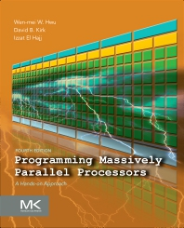
Recommended Readings (II)
Hwu and Kirk and El Hajj, “Programming Massively Parallel Processors,” Fourth Edition, 2022
  Chapter 7 - Convolution: An introduction to
  constant memory and caching
  Chapter 8 - Stencil
  Chapter 16 - Deep learning

Slide 62
P&S Heterogeneous Systems
Advanced Tiling for Matrix Multiplication
Dr. Juan Gómez Luna
Prof. Onur Mutlu
ETH Zürich
Fall 2022
28 November 2022

